Slide 1
The End oF The NIMS Rainbow – Revisited local emergency management

Slide 2
This afternoon
Discuss: Why being resilient is important …
Discuss: Who is equipped to do it …
Discuss: How it can be done …

Slide 3
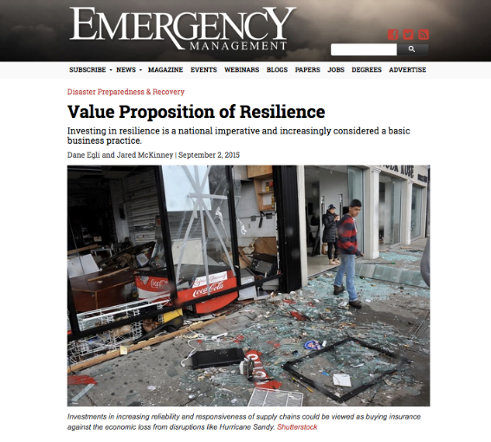
Why this is important

Slide 4
Egli Said …
“By creating a more connected world, globalization and technology have increased transparency and business efficiencies while simultaneously making systems more vulnerable.”
“Businesses have more complex supply chains than ever before, allowing for greater speed and specialization.”

Slide 5
Egli Said …
“Outsourcing allows businesses to benefit from the competitive advantage of diverse countries and companies. Purchasing from a single source reduces costs. Just-in-time delivery is reducing inventory and excess capacity.”
“Businesses have more complex supply chains than ever before, allowing for greater speed and specialization.”

Slide 6
Egli Said …
“But these advances have also resulted in cascading impacts due to a global system with little room for error, in which a local disruption adversely impacts the entire supply chain in distant locations. This connectedness amplifies the consequences of small, local disruptive events as well as high-impact but low-probability “Black Swan” events.”
“There is a direct relationship between efficiency and risk.”

Slide 7
https://www.nbcnews.com/nightly-news/video/maryland-town-devastated-by-deadly-weekend-flooding-736244803535

Slide 16
Who is equipped to do it?
The Essential Emergency Manager

Slide 17
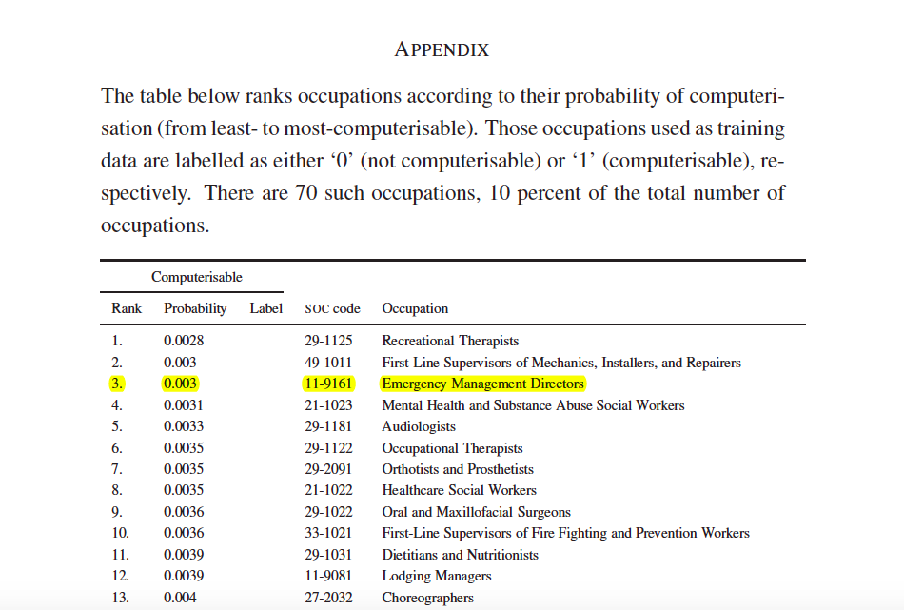
What makes you so Special?

Slide 18
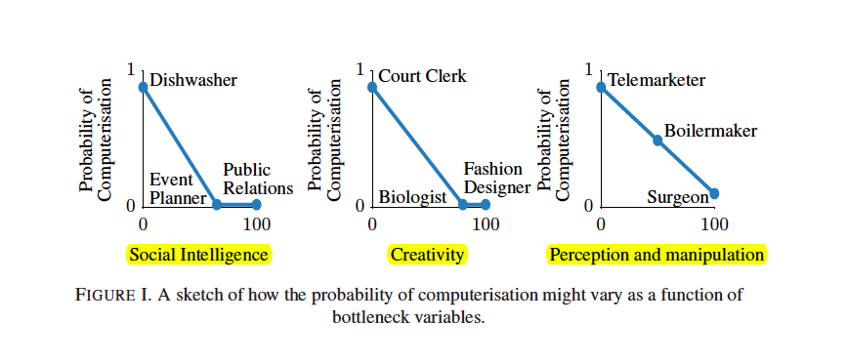
What makes you so Special?

Slide 19
Enrico Quarantelli 1924-2017

Slide 20
How it can be done …
Focus on the planning process rather than the production of a written document
Recognize that disasters are both quantatively and qualitatively different from minor emergencies and everyday crises.
Be generic rather than agent specific.
Avoid the development of a "command and control" model
Focus on general principles and not specific details

Slide 21
How it can be done …
Be based on what is likely to happen
Be vertically and horizontally integrated
Strive to evoke appropriate actions by anticipating likely problems and possible solutions or options
Use the best social science knowledge possible and not myths and misconceptions.
Recognize that crisis time disaster planning and disaster managing are separate processes

Slide 22
Thank You
Ryan Miller
ramiller@howardcountymd.gov
410-313-6032

