Slide 1
Analysis and Decision-Making in EMS
John Warchal, MS
FP-C, CCP-C, TP-C

Slide 2
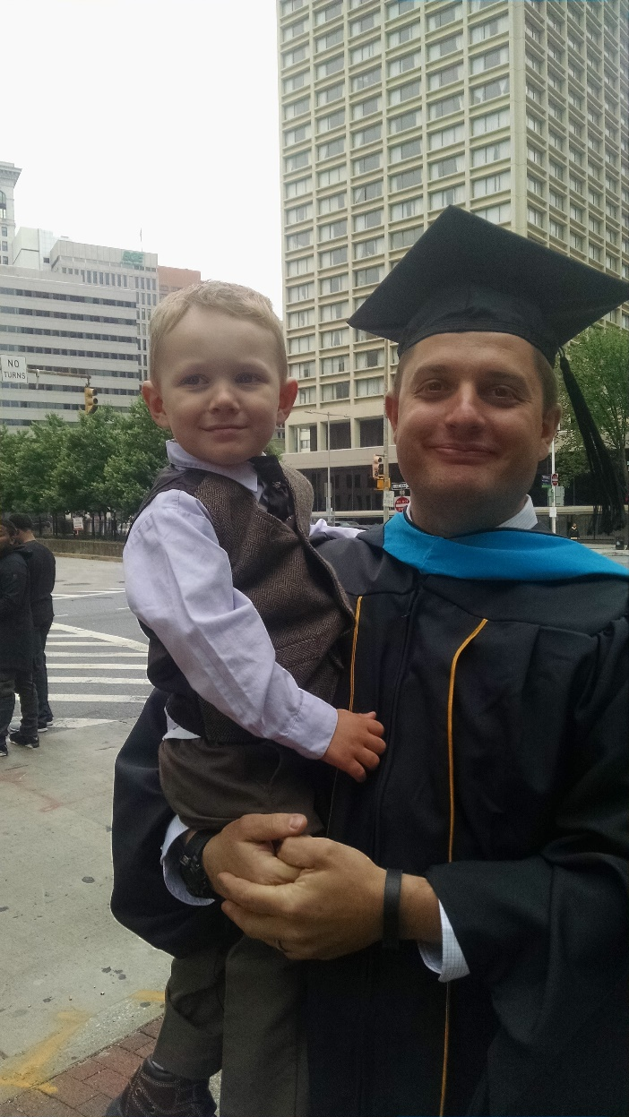
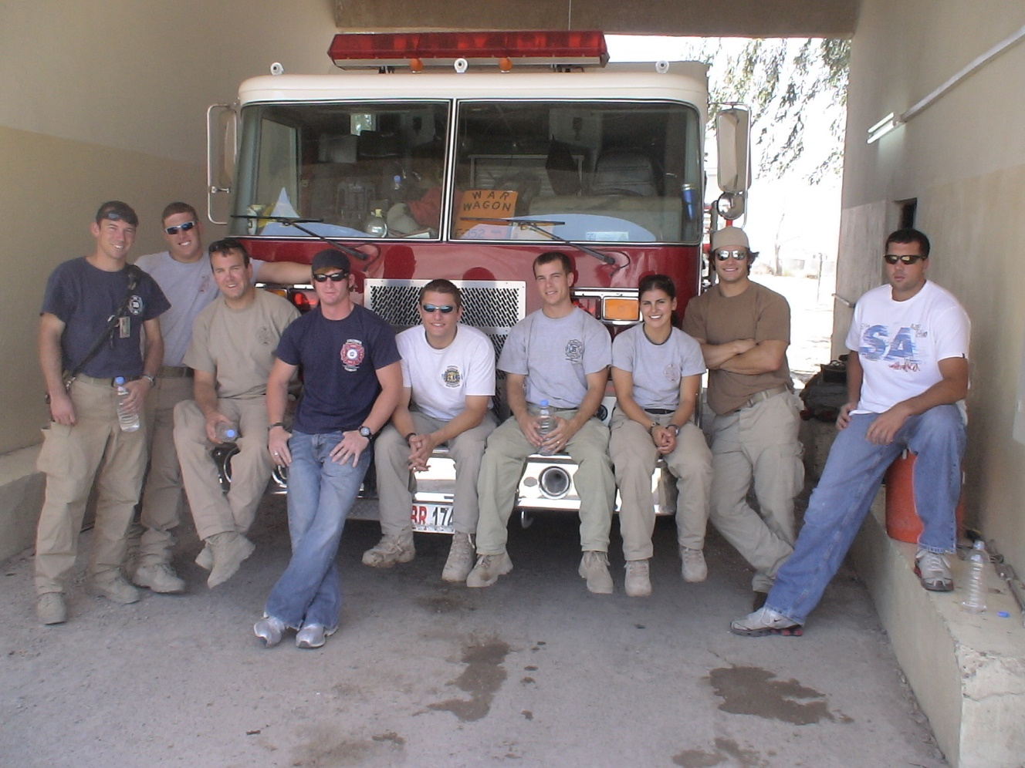
A Little About Me

Slide 4
What is the most important skill for EMS providers and leader?
Making Appropriate Decisions

Slide 5
Decision-Making
What is it?
Why is it important to me?
Why is it important in emergency response?
What is the process?
How is it different than simple process analysis?
ACTION
How do I improve the process?

Slide 6
Goals/Objectives
“Begin with the end in mind” – Stephen R. Covey
Making decisions as a clinician, supervisor, or executive requires a clear understanding of your mission, goals, and values.
This remains constant whether deciding on what to eat for lunch, treating a critical patient, or deciding on a multi-million dollar system budget item.

Slide 7
Framework for Decision-Making
Frame/ Perspective
Sources of Information/Data
Education
Training
Experience
Policies/Procedures
Beliefs/Background
Position/Rank
“Gut Feeling”
Size-up
Dispatch/ Communications
Patient Presentation/Assessment
Patient/Caller Report
Reports/Research
Provider/Industry Consensus
Analytics

Slide 8
The Keys to Decision-Making
Frame/Perspective
Process/Analysis
Objective/Outcome
Data/ Information
Parameters

Slide 9
Types of Decisions
Programmed (Generic) Decision
Common/ Reoccurring situation
Known process and outcomes
Based on procedure/policy - expectation
Non-Programmed (Exceptional) Decisions
Novel/ Unfamiliar situation
Unknown possible outcomes
Incomplete data/information

Slide 10
Decision Conditions
Certainty
Known outcomes and resources
Risk
Probable outcomes, but may have unknown consequences
Uncertainty
Completely unknown outcomes

Slide 11
Decision-Making Process
Determining the conditions
Is the decision/situation familiar?
Are the potential outcomes known or unknown?
What is the risk inherent in the decision?
Notes:
Dolan 24 hr rule

Slide 12
Decision-Making Process
How much information do you need to make a decision? How much do you have?
How much time do you have? What resources do you have?
Are there limitations on your possible courses of actions?
Group decision or individual decision?

Slide 13
Decision-Making Process
Can you change the conditions?

Slide 14
Analysis
What are your sources of data/information?
What is the information reliability?
Can you get additional data/information?
How accurate is your analysis?
Do you have the time?

Slide 15
Analysis
“80% of Data is 80% Accurate 80% of the Time”

Slide 16
Decision-Making Models
Frame/Perspective
Process/Analysis
Objective/Outcome
Data/ Information
Parameters

Slide 17
Classical/Rational Decision-Making
Identify problem/ situation
Gather information
Develop solutions
Select best solution
Implement solution
Evaluate and adjust

Slide 18
Recognition-Primed Decision-Making
Recognize the problem/situation
Select the first reasonable course of action
Implement the action
Experience

Slide 19
OODA Loop
https://en.wikipedia.org/wiki/OODA_loop#/media/File:OODA.Boyd.svg

Slide 20
Observe and Orient

Slide 21
Other Models
PDCA – Plan, Do, Check, Act
Demming/Shewart
Capture, Clarify, Organize, Reflect, Engage
David Allen
DMAIC – Define, Measure, Analyze, Improve, Control
Six Sigma

Slide 22
Barriers to Decision-Making
Internal
External
Fear
Ego
Indecisive
Distrust
Antagonism
Jealousy
Wrong motivation
Lack of data/information
Inaccurate analysis
Lack of resources
Lack of support
Lack of commitment
Lack of capacity

Slide 23
Evaluating Decisions
How do you determine whether a decision is good or bad?
Are there different criteria for different perspectives/frames?
Do you have the ability to revise your decision or approach?
How well does your decision match your goals? What about your expectations?

Slide 24
Good or Bad Decision?

Slide 25
Group Decisions
Consensus v. Conflict

Slide 26
Examples and Discussion
Patient Care
Scene Management
System Design
Dinner?

Slide 27
Questions
?

