Slide 1
Writing for Emergency Management
…and tips for other types of writing too!

Slide 2
Why this topic?
Students (and people in the work force) struggle with writing
You likely have a final project/paper to write in the near future
Poor writing on a job application can cost you the job
Well-written papers are easier to grade

Slide 3
Which one is better?
A | Maryland State Police, as the lead agency for coordinating law enforcement activities throughout the State, will be facilitating a conference call with interested partner agencies to discuss potential deployment to Puerto Rico. Please have a representative from your agency on the call.
B | MSP, as the ESF-13 lead, is hosting a coordination call to discuss the open EMAC for Puerto Rico. Please remind your SEOC rep.

Slide 4
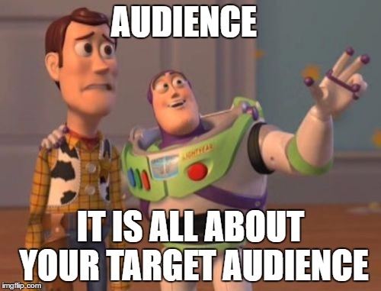
Rule 1 – Know your Audience
What is the purpose of the document?
Expert? Or brand new to the topic?
What format is appropriate?
What length is appropriate?

Slide 5
Which one is better?
Question – What is your favorite brand of coffee? Explain.
A | Dunkin’ Donuts coffee is my favorite brand of coffee because it is relatively cheap and doesn’t taste burnt.
B | There are many different brands of coffee that are readily available to consumers in the Baltimore metro area. People make their coffee selections based on a multitude of factors.

Slide 6
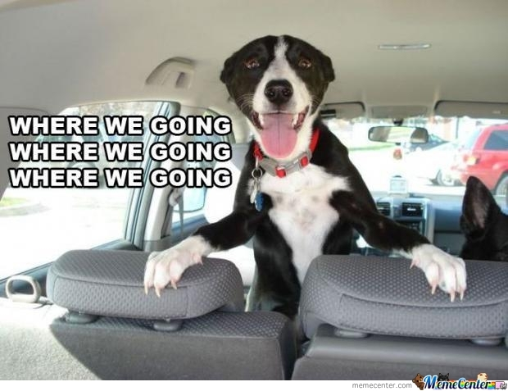
Rule 2 – Start with the end in mind
What is the point of what you’re saying?
Answer the question that is being asked
If it doesn’t tie to the point, it shouldn’t be included

Slide 7
Which one is better?
Question – What is the difference between pre-disaster recovery planning and post-disaster recovery planning?
A | There are many differences between pre-disaster and post-disaster recovery planning. Specifically, the style of document produced, the stakeholders involved, and the objectives of the plans vary greatly.
B | Pre-disaster and post-disaster recovery planning involve many differences. Because of the nature of these two different types of planning many things will be different about the documents that are produced.

Slide 8
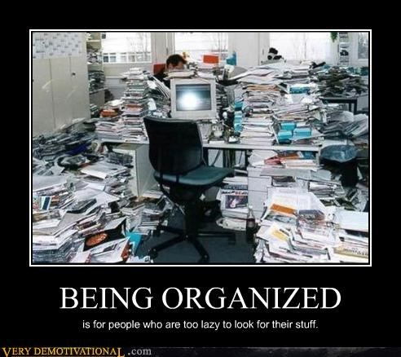
Rule 3 – organization is your friend
Use outlines before you write
Make sure you answer all parts of the question
Don’t be afraid to use bullets and headings

Slide 9
Which one is better?
A | The author connects theory with exampled evidence to make these points and to formulate an unflinching case for awareness of the paper plan syndrome as a threat to disaster response vitality.
B | The author makes a strong case for the need for emergency managers to understand the paper plan syndrome.

Slide 10
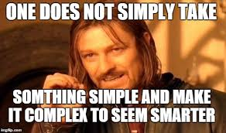
Rule 4 – Keep it Simple
Less is more – shorter words, shorter sentences
Bigger words don’t make you sound smarter, they just distract the reader
Big words won’t cover it up if you don’t know the material

Slide 11
Which one is better?
A | Your welcome for the support last week. I look forward to working with you and your Team again in the future.
B | You’re welcome for the support last week. I look forward to working with you and your team again in the future.

Slide 12
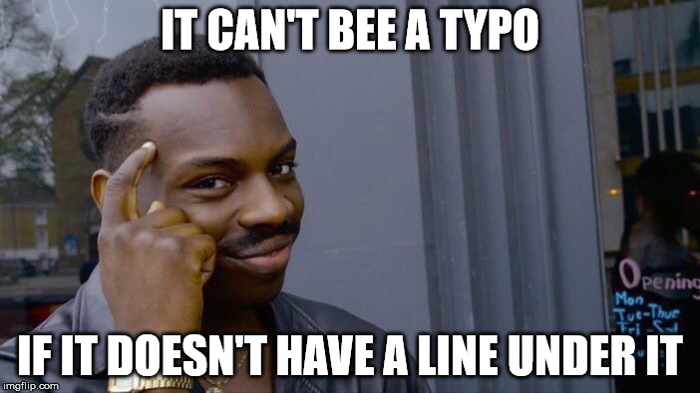
Rule 5 – Proofread. then Proofread Again
Edit without mercy
Fresh eyes are always better
If spellcheck found it – fix it!
Spellcheck doesn’t catch everything!
Read it out loud to yourself

Slide 13
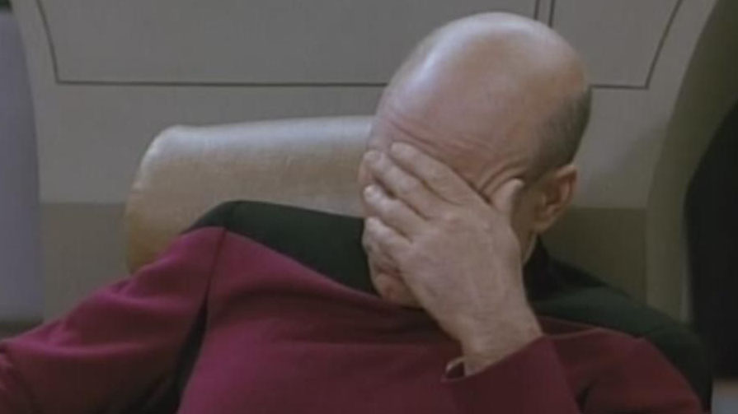
Bonus Rule– If you didn’t write it, it didn’t happen
If you don’t write it, the grader doesn’t know you know it!
Don’t automatically assume your reader knows something

Slide 14
Summary
Know your audience
Start with the end in mind
Organization is your friend
Keep it simple
Proofread, and then proofread again
If you didn’t write it, it didn’t happen

