Slide 1
Refugees
The 21st Century Chronic Catastrophe
Women & Children Protection

Slide 2
The 1951 Refugee Convention
•The key legal document that defines the term ‘refugee’ and outlines the rights of the displaced, as well as the legal obligations of States to protect them.
•Asserts that a refugee should not be returned to a country where they face serious threats to their life or freedom. This is now considered a rule of customary international law.

Slide 3
Some Definitions...
•Who is a refugee?
•Who is an internally displaced person IDP?
•Who is a stateless person?
•Who is an asylum seeker?

Slide 4
Who Is A Refugee?
•According to the UN Refugee Agency “A refugee is someone who has been forced to flee his or her country because of persecution, war, or violence”.
•Currently, there are 5,029,562 registered Syrian refugees in several countries such as Turkey, Lebanon, and Jordan. (war)
•Note: environmental changes do NOT fall under the UN definition.

Slide 5
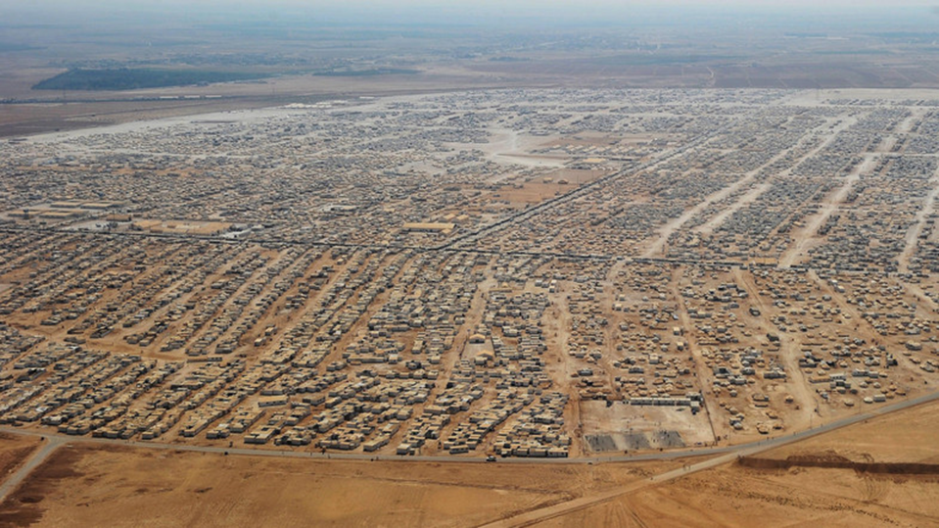
Behind the Fences of Jordan's Zaatari Refugee Camp
Notes:
https://www.google.com/search?q=refugee+camps+in+jordan&source=lnms&tbm=isch&sa=X&sqi=2&ved=0ahUKEwi476ns_b3TAhXl4IMKHeWuAm4Q_AUIBygC&biw=1276&bih=655&dpr=2#imgrc=iGLXohVNWtIRXM:

Slide 6
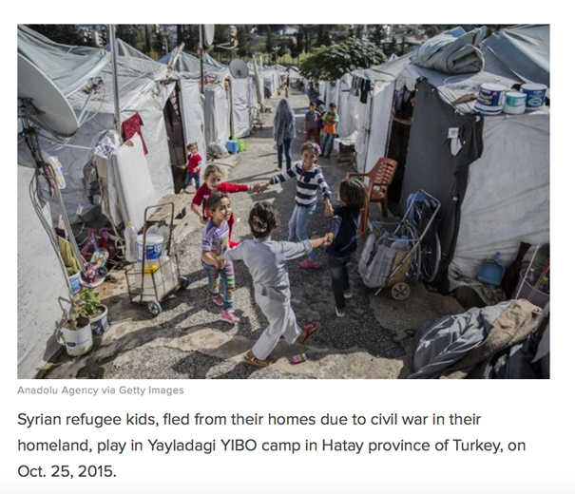
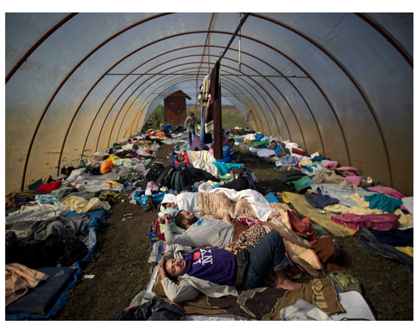
Syrian children refugees, fled their homes to Turkey due to civil war. 2015
Syrian people in temporary camp for asylum seekers near Hungarian border. 2015.
Notes:
http://time.com/4024210/climate-change-migrants/

Slide 7
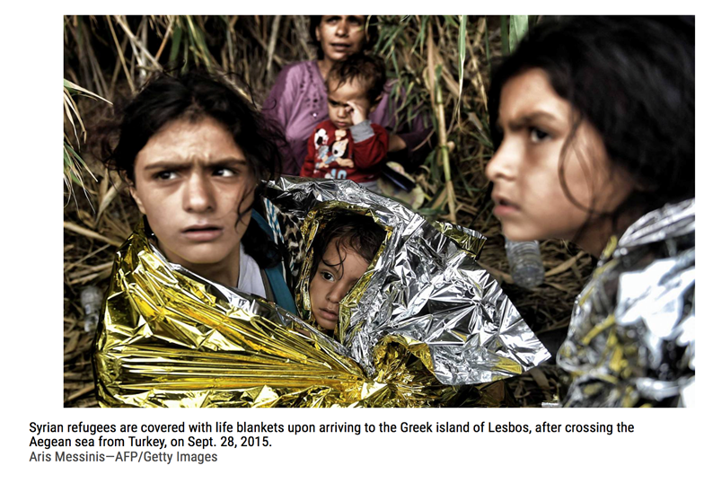
Notes:
http://time.com/4024210/climate-change-migrants/

Slide 8
Who Is An Internally Displaced Person (IDP)?
•“A person who has been forced to flee his or her home for the same reason as a refugee, but remains in his or her own country and has not crossed an international border”.
•“Unlike refugees, IDPs are NOT protected by international law or eligible to receive many types of aid”. (from a public health standpoint it does not matter)
•The Internal Displacement Monitoring Centre (IDMC) estimates that there are almost 2,152,000 internally displaced people (IDPs) in Nigeria as of 31 December 2015. (Boko Haram, religious).
Notes:
http://www.internal-displacement.org/sub-saharan-africa/nigeria/figures-analysis

Slide 9
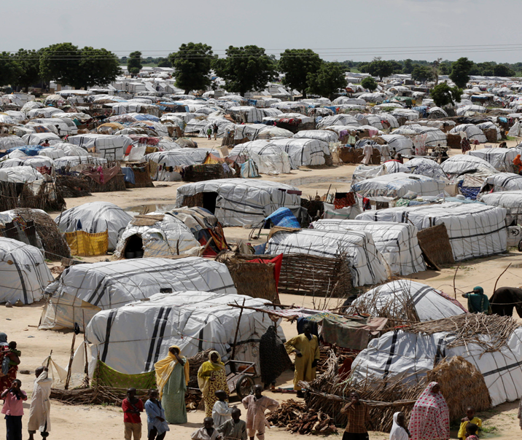
One of the biggest camps for people displaced by Islamist extremists in Maiduguri, Nigeria
Notes:
https://www.google.com/search?q=refugees+on+trains&source=lnms&tbm=isch&sa=X&ved=0ahUKEwiYm_eGhr7TAhVIMSYKHUidCyQQ_AUIBigB&biw=1276&bih=655&dpr=2#tbm=isch&q=boko+haram+displaced+nigerians&imgrc=g0-4brdehA0JcM:

Slide 10
Who Is A Stateless Person?
•“A stateless person is someone who is not a citizen of any country”.
•A person can become stateless due to a variety of reasons, including sovereign, legal, technical or administrative decisions or oversights.
•Example: Over 170,000 Syrian babies have been born in Turkey since start of war. Are they Syrian? Are they Turkish?
Notes:
http://www.middleeasteye.net/news/170000-syrian-babies-born-turkey-start-war-1141301542

Slide 11
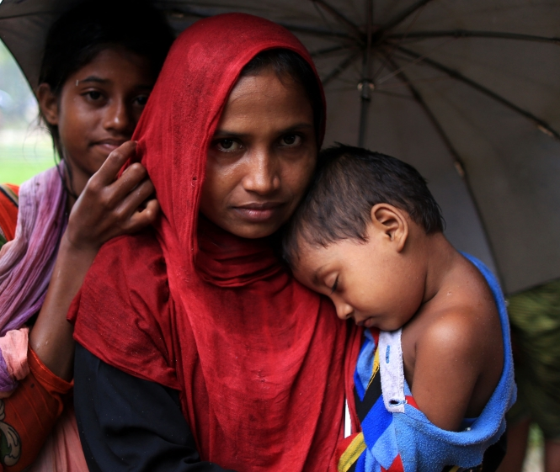
The Rohingya Crisis
Myanmar does not recognise the Rohingya as an ethnic group.
https://www.youtube.com/watch?v=F25qrkboV3o
Notes:
http://www.aljazeera.com/indepth/features/2017/08/rohingya-muslims-170831065142812.html

Slide 12
Who Is An Asylum Seeker?
•“When people flee their own country and seek sanctuary in another country, they apply for asylum – the right to be recognized as a refugee and receive legal protection and material assistance”.
•Note: the difference between an asylum seeker and a refugee is mostly procedural.
Asylum seekers need to be interviewed individually and determined if eligible vs. mass movement of refugees.

Slide 13
Facts About Refugees…
https://www.youtube.com/watch?v=RstxqdvwFIo

Slide 14
Quick Review

Slide 15
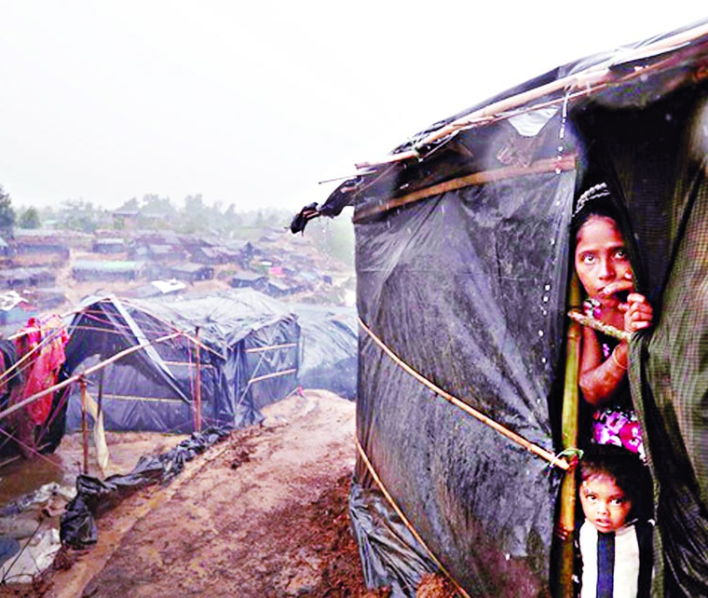
Public Health Sequelae Of Refugees
According to UNHCR 9/10 refugees settle in developing countries that already lack resources and have a fragile healthcare system.
Notes:
http://journals.plos.org/plosone/article/file?id=10.1371/journal.pone.0168820&type=printable
http://thedailynewnation.com/library/1505664391_1.jpg

Slide 16
Challenges Faced By Refugees

Slide 17
Different laws
Different languages
Different cultural needs
Different educational and healthcare systems
Discrimination
Different skills (Examples?)
Safety

Slide 18
Difficulties In Hosting Refugees

Slide 19
Disease outbreaks
Food and land scarcity
Unsafe drinking water
Wage competition
Overburdened school and health care facilities
Environmental degradation
Higher rates of criminality and conflict

Slide 20
Violence Against Women & Children

Slide 21
Sexual & Gender-Based Violence (GBV)
The majority of victims or survivors of sexual and gender-based violence worldwide are women and girls (unicef).
40-70% of homicides of women are committed by intimate partners
1:3 women has been beaten, coerced into sex, or abused
Sex trafficking 36-62%
Sex-selective abortion, infanticide, or neglect has prevented the birth of over 60 million females
Rape is a common tactic for men to assert control/dominance during wartime
More than 20,000 Muslim women were raped during the war in Bosnia.
At least 250,000, perhaps as many as 500,000, women were raped during the 1994 genocide in Rwanda
Notes:
https://www.ncbi.nlm.nih.gov/pmc/articles/PMC5192570/
http://apps.who.int/iris/bitstream/10665/77394/1/WHO_RHR_12.42_eng.pdf

Slide 22
Why Women & Children are Targeted?

Slide 23
War Strategy: “Tactic of Terror”
Method to Assert Dominance
Breakdown of social structures
Absence of consequences
Notes:
Read more at: http://www.nationalreview.com/article/449526/afghan-refugees-rape-jihad-europe
http://www.aljazeera.com/indepth/features/2017/09/rohingya-refugees-share-stories-sexual-violence-170929095909926.html
https://www.washingtonpost.com/world/africa/they-were-freed-from-boko-harams-rape-camps-but-their-nightmare-isnt-over/2016/04/03/dbf2aab0-e54f-11e5-a9ce-681055c7a05f_story.html?utm_term=.8ed4f07cc237

Slide 24
Examples
2. al-Qaeda terrorists were known for systematically raping women.
Shame females into becoming suicide bombers
After brutal gang rapes, they were told that the only way they could “redeem” their allegedly lost honor was to “sacrifice themselves”
Rapists view Europeans as the enemy, and their women are legitimate spoils, as are all the other things one can take from them: housing, money, passports
They think they are “entitled” to women’s bodies
3. Army troops in Myanmar attack villages by reclaiming resources by force, murder men, target women and children by raping, torturing, and burning them to “cleanse” the region.
Humiliated through rape before they are murdered
Typically raped in groups/publically
Young boys are captured and converted to Buddhism
1. Boko Haram abduct, rape, and force women and children into marriage.
After taking the women and children, Boko Haram murder the men and burn the villages
Women and children had nowhere to return/flee
Raped often=impregnated quickly
Children will follow new ideology
Women are now considered dangerous “Boko Haram Wives”
Mistrust: Suicide Bombs, Monitored by Boko Haram

Slide 25
Business: Human & Sex Trafficking
Women and Children:
Sex Work/Prostitution
Sweatshops/Forced Labor
Agriculture
Forced Marriages
Domestic Servitude
Children are disappearing at alarming rates
Easy to recruit
Easy to replace
Easy to control
Manipulate emotionally and physically
Cheap and discreet
** Trafficked children (6mo-10yrs) are bought and sold for approximately €4,000 (4,700$) to €8,000 (9,400$).

Slide 26
Travel Route Exploitation
"The Central Mediterranean from North Africa to Europe is among the world’s deadliest and most dangerous migrant routes for children and women,"-Afshan Khan, UNICEF Regional Director and Special Coordinator for the Refugee and Migrant Crisis in Europe, said in a statement.
“The route is mostly controlled by smugglers, traffickers and other people seeking to prey upon desperate children and women who are simply seeking refuge or a better life," Khan said. "We need safe and legal pathways and safeguards to protect migrating children that keep them safe and keep predators at bay.”
Notes:
https://www.nbcnews.com/news/world/refugee-crisis-women-children-report-sexual-violence-abuse-migration-trail-n726731

Slide 27
Culture
Breakdown of Family & Community Structure
Before relocation, men provided for the family
Tensions with other cultures &/or religions are amplified
Work, education, and resources are reduced
Family separation, women are reliant on men
“Gender roles and identities usually involve inequality and power imbalance between women and men. Violence against women, and its acceptance within society and cultures, is one of the manifestations of this inequality and power imbalance.”
Notes:
https://emergency.unhcr.org/entry/45582/camp-planning-standards-planned-settlements

Slide 28
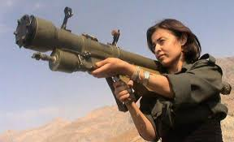
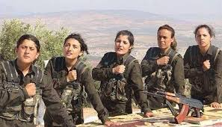
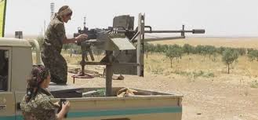
ISIS vs. Kurdish Women
The People's Protection Unit

Slide 29
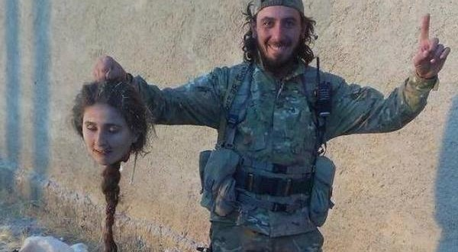

Slide 30
Camp Conditions
Let’s Explore a Refugee Camp
http://www.bbc.com/news/world-middle-east-23801200

Slide 31
Concerns for Camp Conditions
“Residents face a number of challenges - the biggest being security”.
Growth and security have not grown together.
Volunteers & other refugees are perpetrators of rape
Gangs are known to operate across the camp and women are particularly vulnerable to violence.
Lack of safe places
Dwellings did not have a lock
Poor Lighting at night
76% of the population are minors
21% under 5 years old & 55% under 18 years old

Slide 32
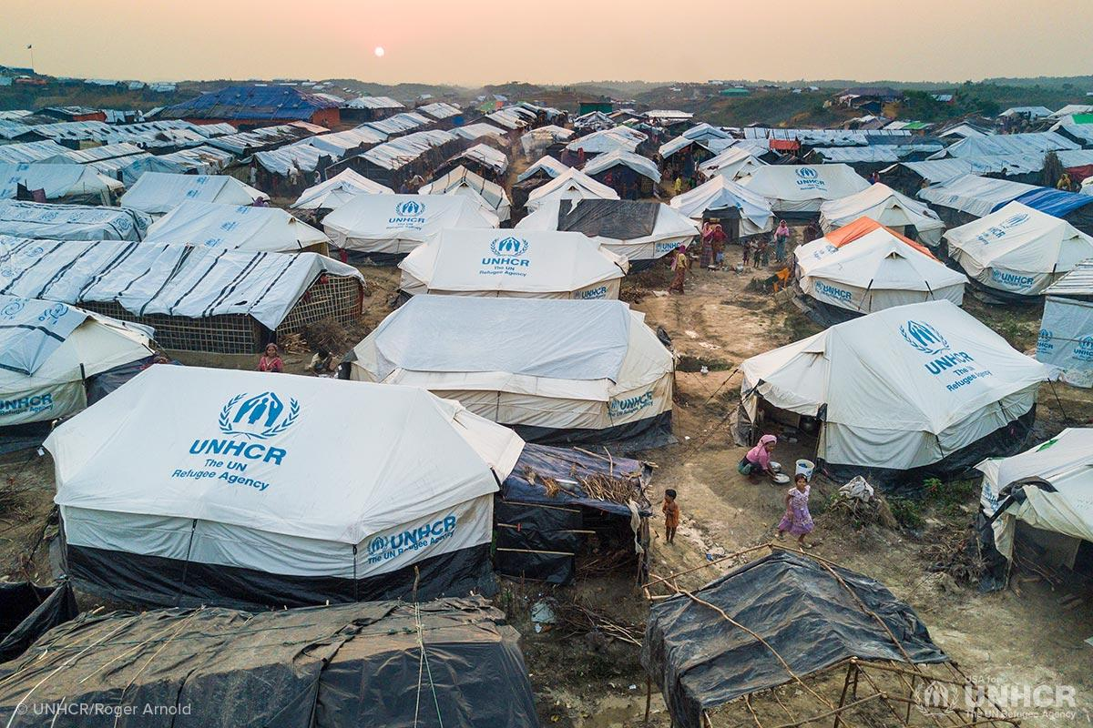
Protection
How do we protect women and children from violence that occurs behind closed doors?
Report the event
Encourage survivors to seek help from local NGOs
Speak out against GBV
Education
UNICEF in Lebanon: Sexual and Gender Based Violence Task Force
Notes:
https://www.unicef.org/lebanon/emergency_8401.html

Slide 33
Barriers to Implement Methods of Protection

Slide 34
Cultural & Religious Barriers
Reporting Is Inappropriate
Victims of sexual violence are not exactly seen as victims.
It is culturally inappropriate to report incidents of sexual violence.
Screaming is “Haram” (sinful)
Notes:
https://www.globalfundforwomen.org/news-update-refugee-crisis/#.Wgo4FGhSw2w

Slide 35
Cultural & Religious Barriers
Lack of Trust
"Haitians are very private people, and it was very difficult to get women to talk about it, they would come in with complaints of symptoms of a vaginal infection or UTI, but with a lot of digging, we would find out they had been raped. Women were also reluctant to speak because most of our translators were men. You can't get a reliable history that way."
Notes:
https://www.medscape.com/viewarticle/720572

Slide 36
Cultural & Religious Barriers
Tolerance of Sexual Violence
Boys will be boys!
For refugee women and children living in camps, violence has become a normalized part of life.
Violence is an outlet.
“Better for me to bear his anger than the broader community” (refugee woman from a camp in Lebanon).
Notes:
https://www.globalfundforwomen.org/news-update-refugee-crisis/#.Wgo4FGhSw2w

Slide 37
Cultural & Religious Barriers
Forced & Child Marriage
An opportunity to keep their daughters safe, to protect family honor, and to get out of poverty given their limited economic options.
Forced and child marriage is not seen as a form of violence.
Notes:
https://www.globalfundforwomen.org/news-update-refugee-crisis/#.Wgo4FGhSw2w

Slide 38
Broken Reporting System
Privacy
Repercussions for survivor but NO consequences for perpetrator
Lack of trust
Women reporting to men

Slide 39
Lack of Prevention

Slide 40
Uncoordinated Efforts
Bringing in multiple NGO’s can create overlap or leave gaps in services
Gaps create an unmet need
Overlap can create tension between NGO’s
Can lead to misuse of resources and black market trading

Slide 41
Misuse of Laws
One example is reflected in the increase of unaccompanied children:
2010= 66,000 …. Now? 2016= 300,000 (100,000 trying to cross Mexico border, 200,000 applied for asylum in over 80 different countries)
According to UNICEF, the data is incomplete.
Why are the numbers increasing? Policies. Desperation. Increase of Violence. Etc...
Notes:
https://www.acf.hhs.gov/orr/programs/refugee-social-services
https://www.nytimes.com/2017/07/05/us/detained-immigrant-children-are-entitled-to-hearings-court-rules.html
http://www.aljazeera.com/news/2017/05/unicef-number-unaccompanied-refugee-children-soars-170518063920980.html

Slide 42
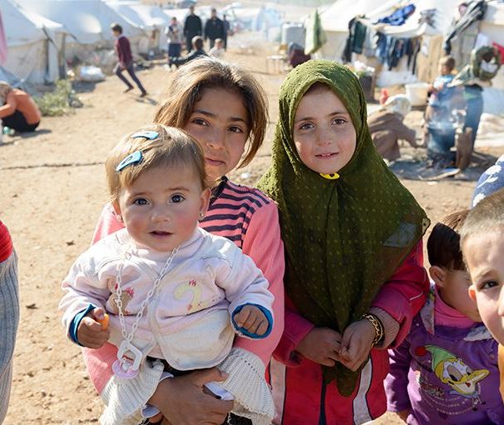
Children Raising
Children

Slide 43
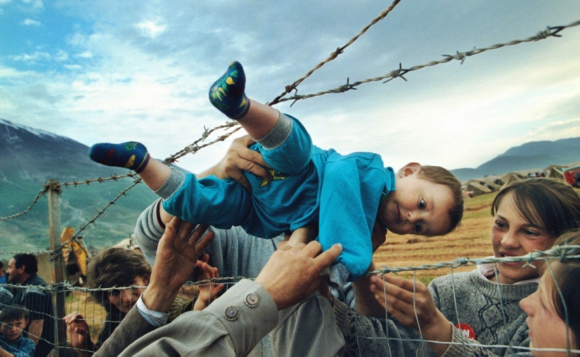

Slide 44
Stories

Slide 45
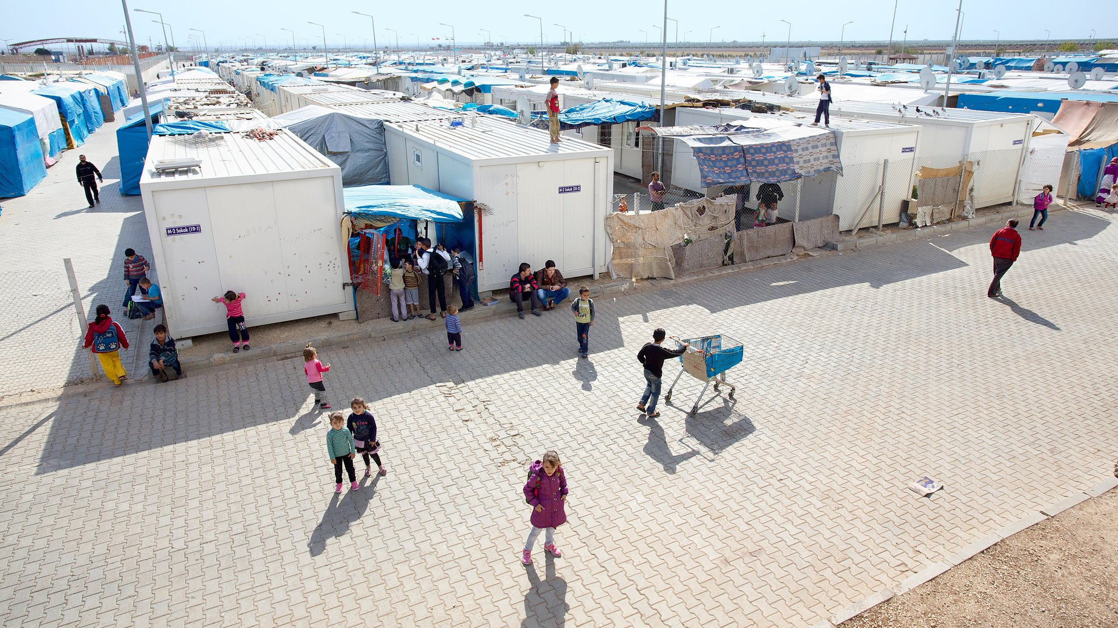
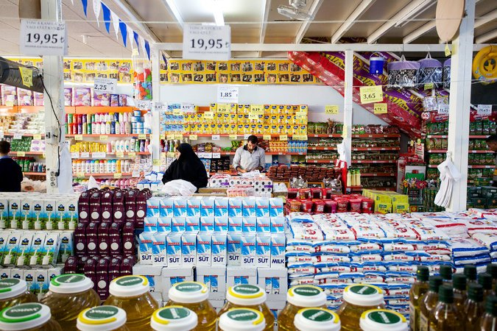
The Perfect Refugee Camp
Kilis Camp
Containers instead of tents
Brick Roadways
Electricity and Running Water
Maintenance
Schools
Grocery Stores
Common Areas with Amenities
Street Lights
Strong Security
Fire Safety
Open Border
Low Crime
Notes:
https://www.nytimes.com/2014/02/16/magazine/how-to-build-a-perfect-refugee-camp.html

Slide 46
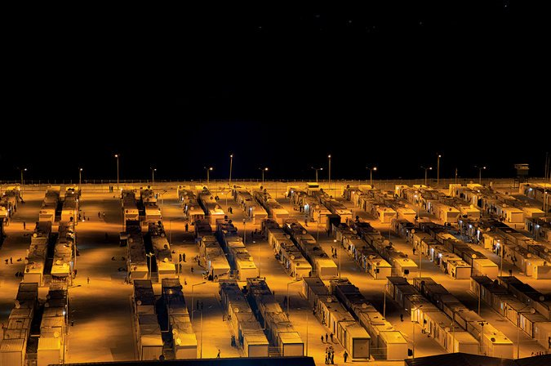
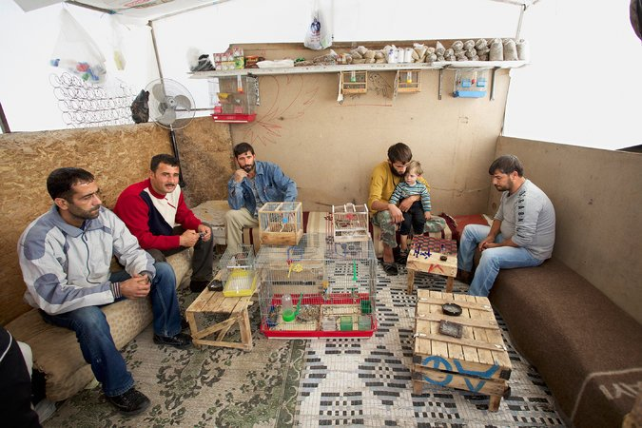
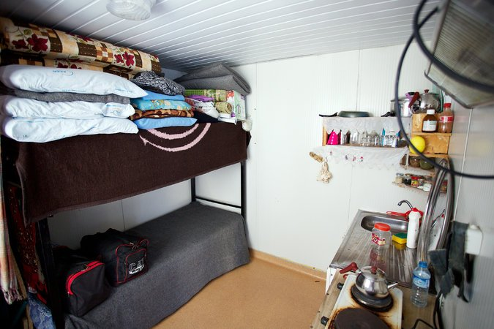
The Perfect Refugee Camp
Refugees are Guests of Turkey and all camps are completely funded by Turkey (no NGO presence)
Turkey spends $2.5 billion annually on refugees
Speculated political motives; investment in reputation
Resentment from Turkey natives
Extremely expensive
Long-term continuation after short-term expectations
Notes:
2016 New York Declaration for Refugees and Migrants
“The New York Declaration for Refugees and Migrants expresses the political will of
world leaders to save lives, protect rights and share responsibility on a global scale”
Comprehensive Refugee Response Framework (CRRF)
The four key objectives of the Comprehensive Refugee Response Framework are to:
Ease pressures on host countries;
Enhance refugee self-reliance;
Expand third-country solutions; and
Support conditions in countries of origin for return in safety and dignity.
UNHCR’s ‘global compact on refugees’
To be presented to 2018 General Assembly
Two part: CRRF & Program of Action
‘Global compact for safe, orderly and regular migration’
Development start in April 2017 as part of NYDRM
To be presented at intergovernmental conference on international migration in 2018 for adoption
http://refugeesmigrants.un.org/global-response
http://www.unhcr.org/en-us/publications/legal/3d4aba564/refugee-protection-guide-international-refugee-law-handbook-parliamentarians.html

Slide 47
Moving Forward
Short Term:
Increase Security and Lighting
Family Planning (male-oriented)
Improve Host Country Site Planning and Oversight of NGO’s
Natural Competition (to prevent black market of supplies)
Engage Refugees in Camps
Long Term:
Resettlement of Refugees: Voluntary Repatriation, Granting Citizenship, or Third-Country Resettlement
Giving Refugees Fulfilling Lives in Permanent Residences
Caring for Urban Refugees
International Policy to Protect Refugees

Slide 48
Questions?
Thank You!

